Slide 1
From Events to Networks: Apply Time Series Analysis at Scale.
Mirko Kämpf | Solutions Architect mirko@cloudera.com

Slide 2

Who is speaking?
Mirko Kämpf
Solutions Architect, EMEA
Data Analysis Projects:
Econodiagnostics: Relation between Social Media & Economy
Analysis of network growth processes
Github: kamir
gephi-hadoop-connector: store networks in Hadoop and plot layouts in Gephi
fuseki-cloud: scale out the RDF meta(data)store
Hadoop.TS3: simplify complex time series analysis processes

Slide 3
Agenda
Recap: The Data Science Process (DSP) Time Series: What, Why, How?
What are Similarity Graphs?
Applications of TSA
Hadoop.TS and HDGS
HDGS: History & High Level Architecture
Outlook

Slide 4
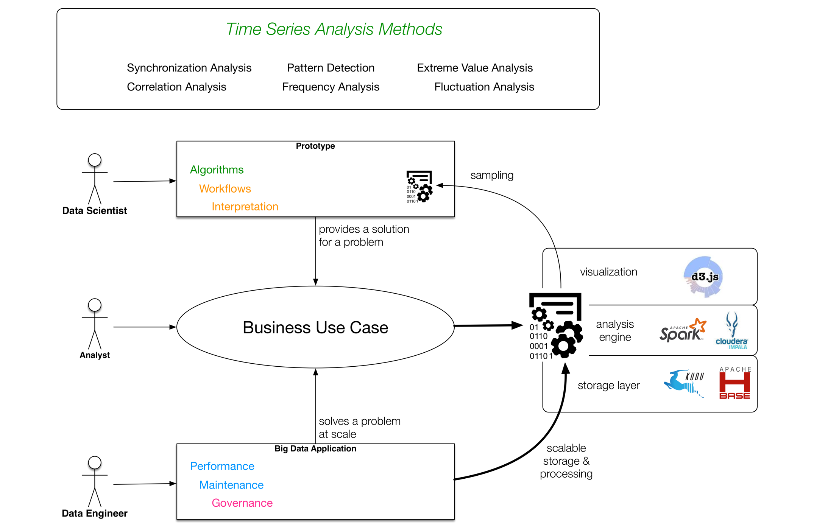
Time Series Analysis on Hadoop:
Data Driven Business:
Domain Knowledge, Science, Math Data Engineering
Efficient Operations
Security
Intuition Algorithms Interpretation
ETL, Workflows Application
Notes:
All starts with a question / problem ?
How has …. Changed (descriptive) ?
What will happen if .... Changes ? (impact)
How will .... evolve? (forecast)
Domain Knowledge and ituition help us to get a starting point
TSA: offers multiple specialities, one has to select the right incredients

Slide 5
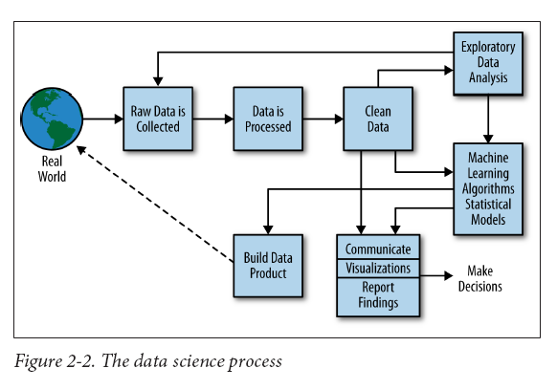
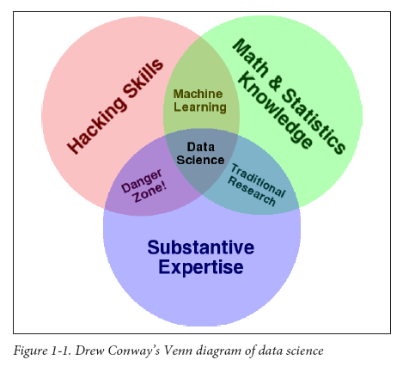
Where are the time series?
Image from: http://semanticommunity.info/Data_Science/Doing_Data_Science

Slide 6
Where are the time series?
events are collected, grouped, and sorted
normalization of raw series
quality inspection
derive new information
Plot useful charts
Visualize related elements as matrix or networks
Derive topological properties
Image from: http://semanticommunity.info/Data_Science/Doing_Data_Science

Slide 7
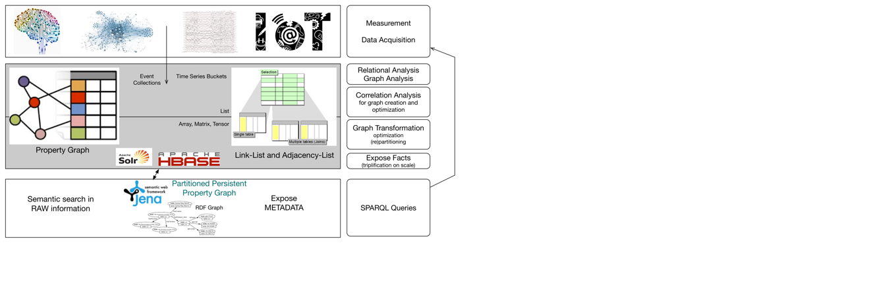
Network Analysis on Hadoop: What is it?
Process collected raw data
Multiple data sets of any kind …
Obviuos and hidden relations between variables. > Structure is not accessible in many cases.
scalable graph analysis in distributed heterogeneous environments
+ time evolution
Notes:
Source for info is:
Measured data from ….
http://images.google.de/imgres?imgurl=http%3A%2F%2F3.bp.blogspot.com%2F-tEkIR2kcyCY%2FVEcQJGrqb3I%2FAAAAAAAAABU%2F9Nj4hxeuqa0%2Fs1600%2FTHAI1.jpg&imgrefurl=http%3A%2F%2Fkonwersatorium1-ms-pjwstk.blogspot.com%2F2014%2F10%2Fthe-human-artificial-intelligence_22.html&h=958&w=965&tbnid=WscyQ01kH-s7CM%3A&docid=sGVehcJYs2-e1M&ei=gy6aV4zmJMX1UqSwsYAO&tbm=isch&iact=rc&uact=3&dur=774&page=1&start=0&ndsp=36&ved=0ahUKEwjMs_6BxpbOAhXFuhQKHSRYDOAQMwhEKAowCg&bih=1058&biw=1804
https://openclipart.org/download/242296/remix-fossasia-2016-contest4.svg

Slide 8
From our experience: The gas laws
The ideal gas law, relates the pressure, volume, and temperature of an ideal gas a compact equation. History of gas laws: Three names in particular are associated with gas laws. (1) Robert Boyle (1627 - 1691), (2) Jacques Charles (1746 - 1823), and (3) J.L. Gay-Lussac (1778 - 1850).

Slide 9
The gas laws
Boyle showed that for a fixed amount of gas at constant temperature, the pressure and volume are inversely proportional to one another.
Boyle's law : PV = constant.
In Charles' law, it is the pressure that is kept constant. Under this constraint, the volume is proportional to the temperature.
Charles' law : V₁ / T₁ = V₂ / T₂
When the volume is kept constant, it is the pressure of the gas that is proportional to temperature:
Gay-Lussac's law : P₁ / T₁ = P₂ / T₂
Indices 1 and 2 represent point in time.

Slide 10
Recap:
We use time dependent variables to describe the system.
Relations between the variable are characteristic for a given system.
Learning or identifying such relations means understanding the systems.
Instead of pressure, volume, and temperature we use:
IT-Operations:
I/O rates
available RAM
system utilization
Financial markets:
trading volume
price
volatility

Slide 11
Network Analysis on Hadoop:
Process collected raw data
Analyze results from previous phases
Relations among variables can be expressed as formulas. (analytical approach) A data driven approach uses pairwise correlations and other statistical measures.
Final results are model parameters, which can be used in analytical models and for forecast.
scalable graph analysis in distributed heterogeneous environments
+ time evolution
Notes:
Results tell us about very specific properties of the system:
Lets look into a thermodynamics:
http://images.google.de/imgres?imgurl=http%3A%2F%2F3.bp.blogspot.com%2F-tEkIR2kcyCY%2FVEcQJGrqb3I%2FAAAAAAAAABU%2F9Nj4hxeuqa0%2Fs1600%2FTHAI1.jpg&imgrefurl=http%3A%2F%2Fkonwersatorium1-ms-pjwstk.blogspot.com%2F2014%2F10%2Fthe-human-artificial-intelligence_22.html&h=958&w=965&tbnid=WscyQ01kH-s7CM%3A&docid=sGVehcJYs2-e1M&ei=gy6aV4zmJMX1UqSwsYAO&tbm=isch&iact=rc&uact=3&dur=774&page=1&start=0&ndsp=36&ved=0ahUKEwjMs_6BxpbOAhXFuhQKHSRYDOAQMwhEKAowCg&bih=1058&biw=1804
https://openclipart.org/download/242296/remix-fossasia-2016-contest4.svg

Slide 12
Network Analysis on Hadoop:
Process collected raw data
Analyze results from previous phases
scalable graph analysis in distributed heterogeneous environments
+ time evolution
Notes:
Results tell us about very specific properties of the system:
Lets look into a thermodynamics:
http://images.google.de/imgres?imgurl=http%3A%2F%2F3.bp.blogspot.com%2F-tEkIR2kcyCY%2FVEcQJGrqb3I%2FAAAAAAAAABU%2F9Nj4hxeuqa0%2Fs1600%2FTHAI1.jpg&imgrefurl=http%3A%2F%2Fkonwersatorium1-ms-pjwstk.blogspot.com%2F2014%2F10%2Fthe-human-artificial-intelligence_22.html&h=958&w=965&tbnid=WscyQ01kH-s7CM%3A&docid=sGVehcJYs2-e1M&ei=gy6aV4zmJMX1UqSwsYAO&tbm=isch&iact=rc&uact=3&dur=774&page=1&start=0&ndsp=36&ved=0ahUKEwjMs_6BxpbOAhXFuhQKHSRYDOAQMwhEKAowCg&bih=1058&biw=1804
https://openclipart.org/download/242296/remix-fossasia-2016-contest4.svg

Slide 13
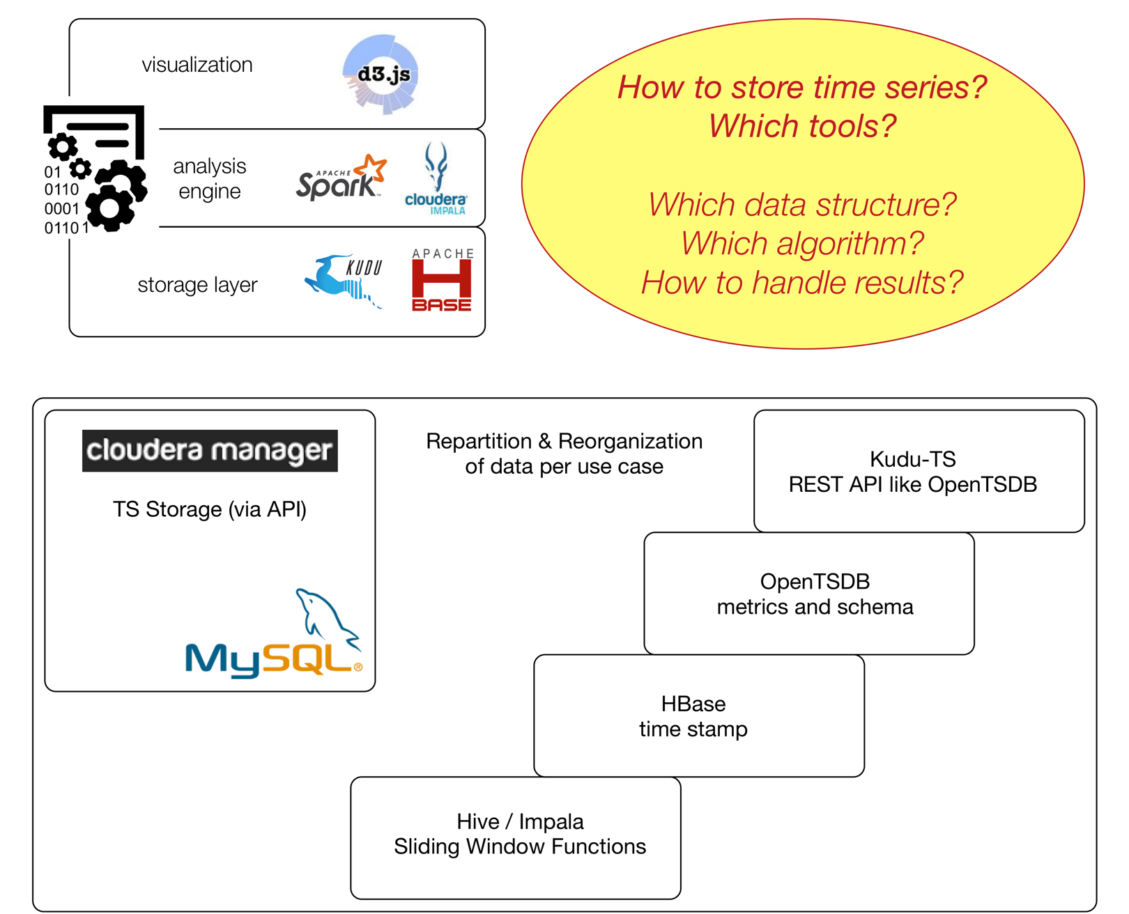
Time Series Analysis on Hadoop:
Hadoop.TS provides data containers & operations:
time series bucket
time series classes
transformations
extractions
HDGS exposes results as semantic network, using a flexible, and generic format by using RDF
Notes:
There are some open questions … (see yellow bubble)

Slide 14
Goals of Hadoop.TS:
Provides abstraction to separate:
data science from data engineering
data from algorithms
results from implementation
Reuse existing analysis algorithms in data driven applications.
Build Time Series related Data Products faster.

Slide 15
Time Series:
What is it?

Slide 16
What is a time series?
y=f(x) … a function?
Let x be time t: y=f(t)
A time series is simply a measure of some thing as a function of time.

Slide 17
What is a time series?
y=f(x) … a function?
Let x be time t: y=f(t)
A time series is simply a measure of some thing as a function of time.
What is t?
Continuous
Discrete (fixed points in time with constant distance)
Unknown points in time

Slide 18
Typical Approaches for Time Based Analysis
Events => single event can be compared with an intent
No history
Complex Even Processing
A series of events
Needs small amount of historical data
Continuous time series processing
Equidistant measures
Needs huge amount of historical data

Slide 19
From Complex Events to Time Series
Univariate:
A series of events / measurements
Limited by a time range
CEP: A known pattern
TSA: A known property such as:
average, volatility, or other parameters of the distribution of values
Multivariate:
CEP: Co-occurrence of events
TSA: Correlation measures

Slide 20
“A time series describes a thing over time.” Many time series describes many things over time.
—Why should I care about time series analysis?

Slide 21
“A time series describes a thing over time.” Many time series describes many things over time. Correlation networks are derived from time series.
—Why should I care about time series analysis?

Slide 22
“A time series describes a thing over time.” Many time series describes many things over time. Correlation networks are derived from time series. Correlation networks describe systems.
—Why should I care about time series analysis?

Slide 23
Time Series:
Available in multiple flavors ...

Slide 24
Typical Time Series (a,c,e) continuous time (b,d,f) spontaneous events

Slide 25
Transformations: TS > ETS > TS

Slide 26
Networks for structural analysis
What is similar among nodes? (a) static properties (b) dynamic properties

Slide 27
Inspection of topological system properties: data quality screening (1)
Visualization of topological structure. Figures are based on term-vectors, stored in a Lucene Index.

Slide 28
Inspection of static system properties: data quality screening (1)
Network nodes are articles (represented as term-vectors). One term-vector per article: … stored in a Lucene index.
Links are given by pairwise distance: cosine-similarity.
Gephi toolkit provides Force directed layout.

Slide 29
Inspection of dynamic system properties: data quality screening (2)
Visualization of the context
Comparison of subsystems

Slide 30
Motivation for Hadoop.TS & HDGS
Overview & Concepts

Slide 31
Challenge:

Slide 32
Uni-Variate Time Series Analysis
Study properties per time series

Slide 33
Distribution of values (PDF) …
Warning: Correlations are not visible in probability
distribution chart!

Slide 34
Impact of Long-Term-Correlations:
P
Warning: Correlations cause non stationarity.
PDF

Slide 35
Detect Long Term Correlation in Time Series
Detrended Fluctuation Analysis Return Interval Statistics

Slide 36
More Time Series Properties:
Is a time series stationary?
Peak detection
Find frequency patterns
Images: - pixel lines and rows can be handled like time series Sound files: - sound analysis and signal analysis are common in engineering and industry
Notes:
The ARIMA model can be viewed as a "cascade" of two models. The first is non-stationary:
{\displaystyle Y_{t}=\left(1-L\right)^{d}X_{t}}while the second is wide-sense stationary:
{\displaystyle \left(1-\sum _{i=1}^{p}\phi _{i}L^{i}\right)Y_{t}=\left(1+\sum _{i=1}^{q}\theta _{i}L^{i}\right)\varepsilon _{t}\,.}Now forecasts can be made for the process {\displaystyle Y_{t}}, using a generalization of the method of autoregressive forecasting.

Slide 37
More Time Series Properties:
Time Series Models:
Auto-Regressive (AR)
Moving average (MA)
Combined: ARMA
Extended: ARMA+TOPOLOGICAL INFORMATION (work in progress)
How to get this structural information? >>> see next part: Multivariate TSA
Notes:
The ARIMA model can be viewed as a "cascade" of two models. The first is non-stationary:
{\displaystyle Y_{t}=\left(1-L\right)^{d}X_{t}}while the second is wide-sense stationary:
{\displaystyle \left(1-\sum _{i=1}^{p}\phi _{i}L^{i}\right)Y_{t}=\left(1+\sum _{i=1}^{q}\theta _{i}L^{i}\right)\varepsilon _{t}\,.}Now forecasts can be made for the process {\displaystyle Y_{t}}, using a generalization of the method of autoregressive forecasting.

Slide 38
Multi-Variate Time Series Analysis
Information, derived from time series pairs

Slide 39
https://imgs.xkcd.com/comics/compass_and_straightedge.png

Slide 40
But: Multivariate TSA allows you … to reconstruct networks.
https://imgs.xkcd.com/comics/compass_and_straightedge.png

Slide 41
Network Reconstruction
INTRA CORRELATION
INTRA CORRELATION
Content Networks:
Cosine-Similarity
Functional Network:
Cross-Correlation
Event-Synchronization
Dependency and Impact:
Granger Causality
Mutual Information
INTER CORRELATION
Question: How can I identify significant links?
Modifications and variation lead to better results in special use cases.

Slide 43
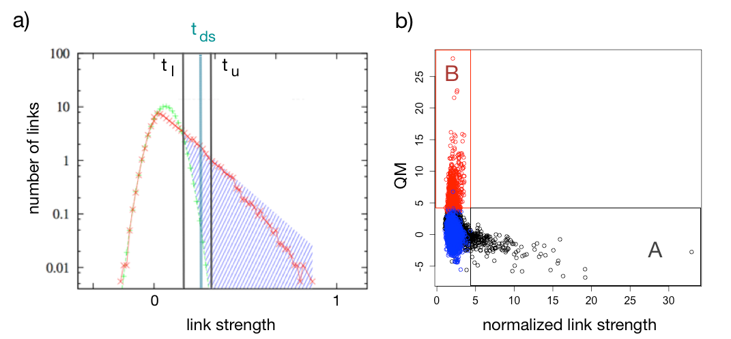
Get Meaning out of Correlation Metrics …

Slide 44
Application of Hadoop.TS:
Results

Slide 45
(1) Usage of Online Content

Slide 46
Usage of Online Content Even if distribution of links is stable we see stuructural changes

Slide 47
(2) Understand Financial Markets

Slide 48
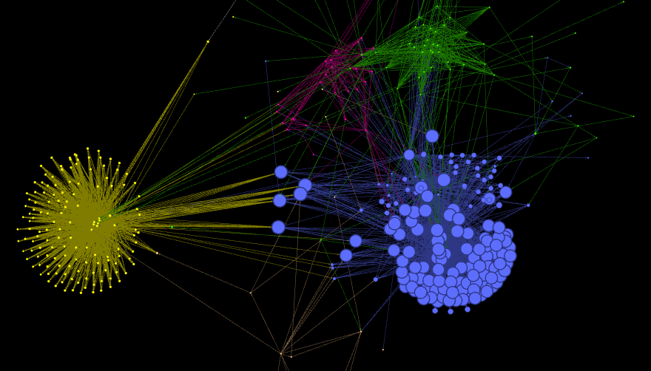
Interconnected Financial Markets: We can identify which nodes connect the markets

Slide 49
HDGS: History & Current Status
Data Flow, Prototype & Architecture Overview

Slide 50
Historical Approach (2012):
Hadoop.TS

Slide 51
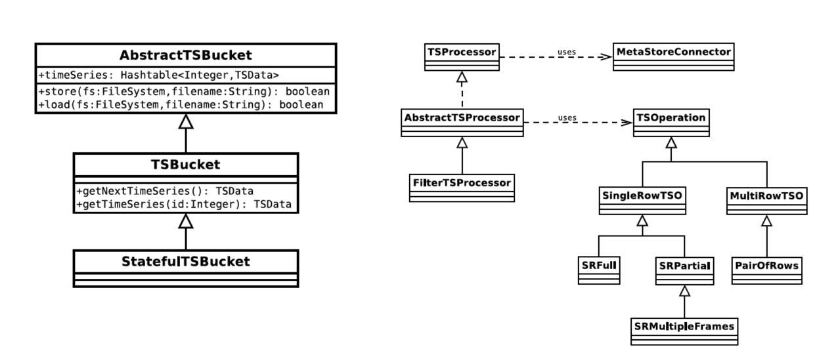
Hadoop.TS (2013)

Slide 52
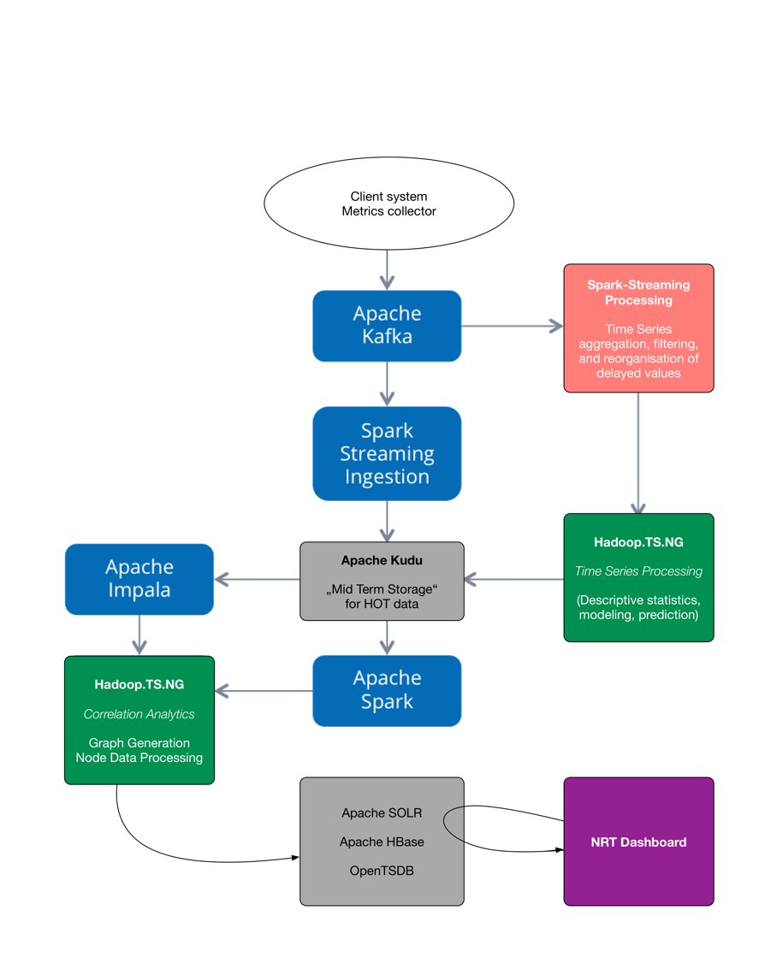
Modern Time Series Analysis:
End-2-end applications need multiple technologies (HBase, Kudu, SOLR, Spark, Impala)
Multiple algorithms are combined (Cross-correlation, Rank-correlation, Wavelet analysis, Frequency analysis, Poisson- or Hawkes-process)
Parameters are often unknown

Slide 53
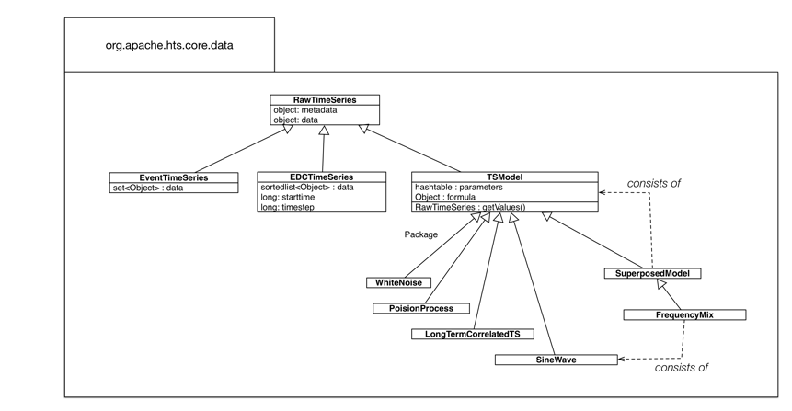
Enhanced Time Series Representations

Slide 54
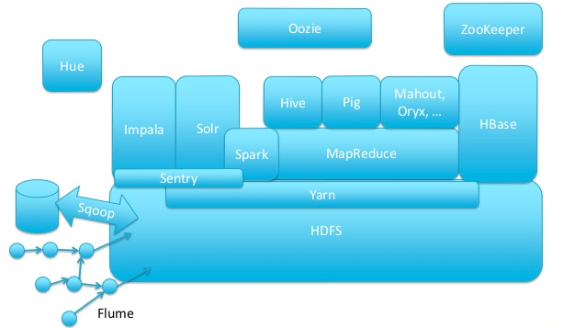
TSA on Apache Spark
Etosha
Hadoop.TS
Time Series Analysis: using spark shell or applications (TSA-workbench) Hadoop.TS provides domain specific functions. Etosha exposes metadata and dataset properties as „linked data“ using RDF.

Slide 55
HDGS: Outlook
... towards an econo-diagnostics toolbox

Slide 56
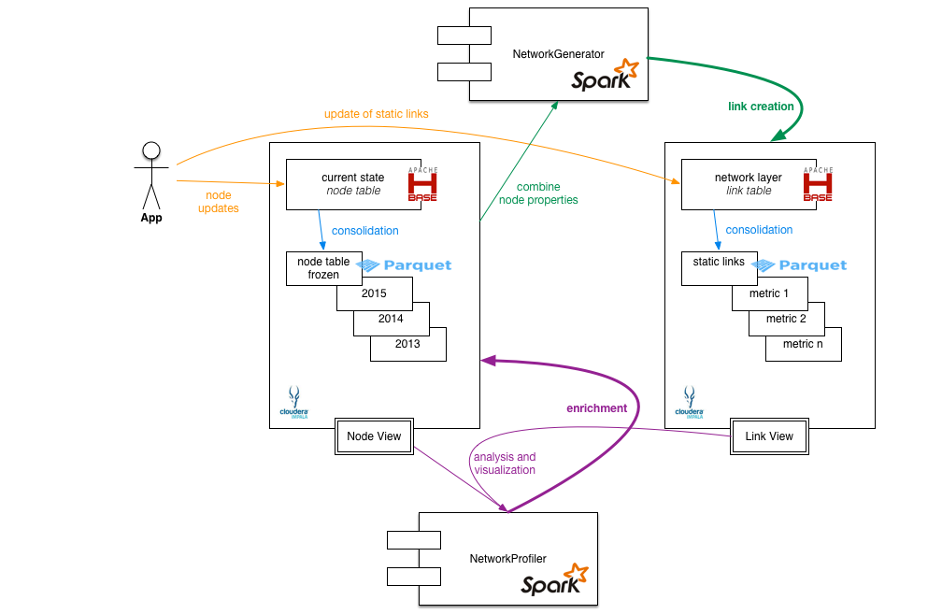
Hadoop Distributed Graph Space (HDGS)
Reconstruction of networks
Profiling of networks
Support for:
Multi-layer networks
Time-dependent multi-layer networks

Slide 57
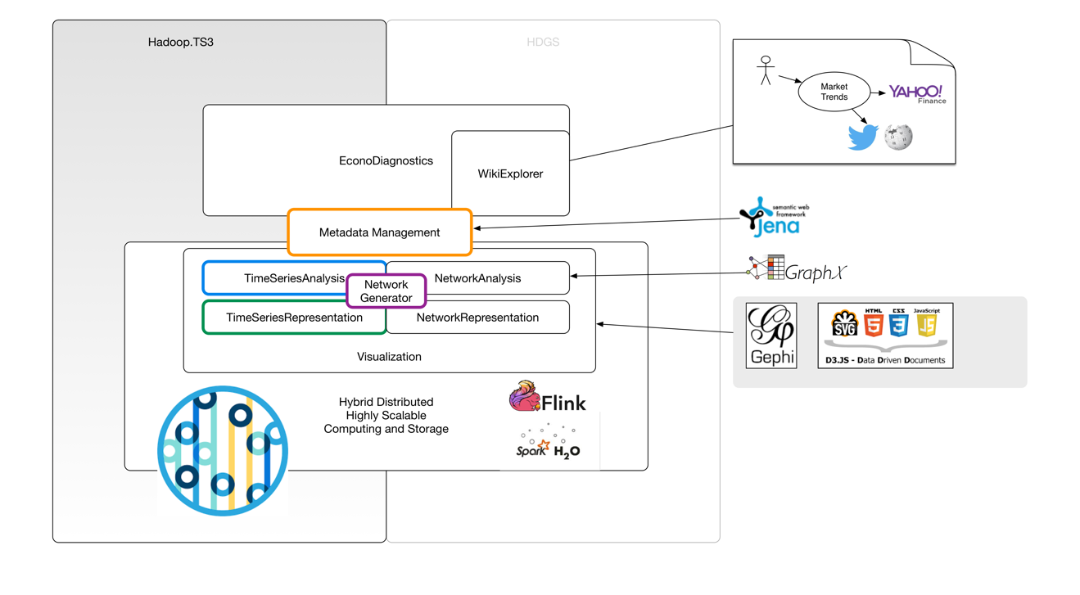

Slide 58
An Oscilloscope for Business Data on Hadoop …

Slide 59
Replace by screen shots ...

Slide 60
Thank you !
Enjoy your time ... Enjoy your data …

Slide 61
Practical Tips

Slide 62
Collecting Sensor Data with Spark Streaming …
Spark Streaming works on fixed time slices only.
Use the original time stamp?
Requires additional storage and bandwidth
Original system clock defines resolution
Use „Spark-Time“ or a local time reference:
You may lose information!
You have a limited resolution, defined by batch size.

Slide 63
Data Management
Think about typical access patterns:
random access to each event, record or field?
access to entire groups of records?
variable size or fixed size sets?
In general, prepare for „full table scan“
OPTIMIZE FOR YOUR DOMINANT ACCESS PATTERN!
Select efficient storage formats: Avro, Parquet
Index your data in SOLR for random access and data exploration
Indexing can be done by just a few clicks in HUE …

Slide 64
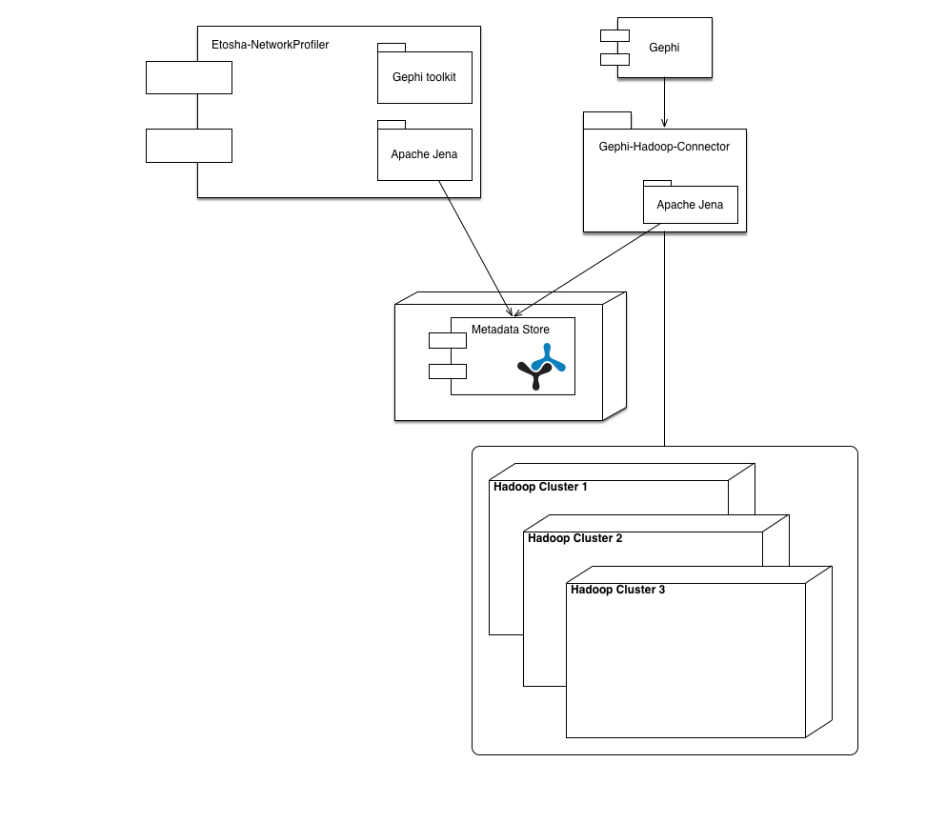
Visualization of Large Correlation Networks
How to manage metadata for time dependent multi-layer networks?
Mediawiki or Fuseki/Jena are available
Gephi-Hadoop-Connector provides access to raw data:
using SQL queries on Impala
using SOLR queries

Slide 65
Gephi-Hadoop-Connector in Action …

Slide 66
Metadata for Multi-Layer Networks

